Slide 1
Retrieval-Augmented Generation (RAG)
Module 07: Grounding LLMs to Cure Hallucinations
Theme: "Giving the Model an Open Book: Accuracy through Context.“
2025+ it is “Context Engineering”
Notes:
Read Kaggle (Google White Paper) on Context Engineering

Slide 2
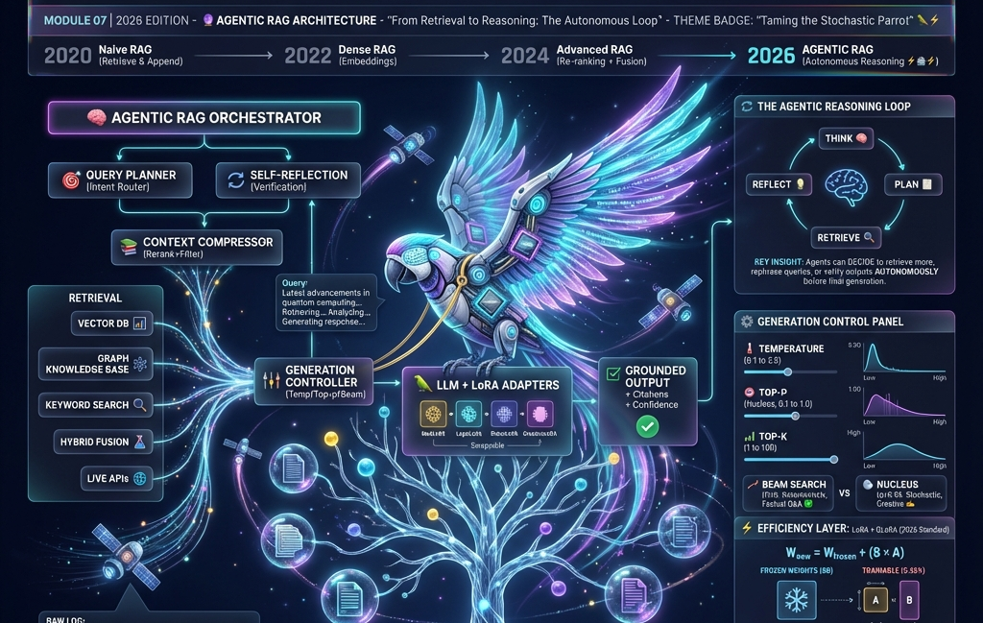
Notes:
For larger image: Agentic_RAG_Architecture_2026

Slide 3

The Two Failures of Frozen Models
1. Knowledge Cutoff:
Scenario: "Who won the World Series in 2025?"
Model: "I do not know" or guesses based on old probabilities.
2. Hallucination:
Scenario: "Summarize the safety manual for this specific robot arm."
Model: Invents a plausible but dangerous procedure.
The RAG Solution: Don't ask to memorize. Ask to process provided facts.

Slide 4
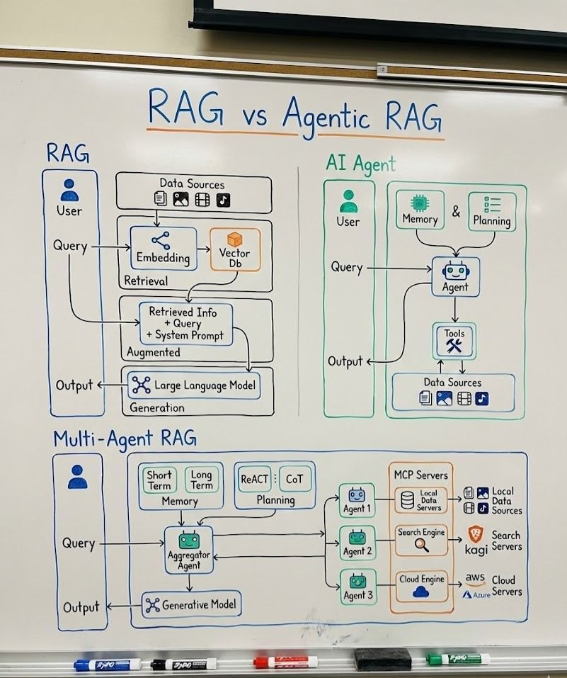
*You are here
Enterprise in 2025
2026

Slide 5
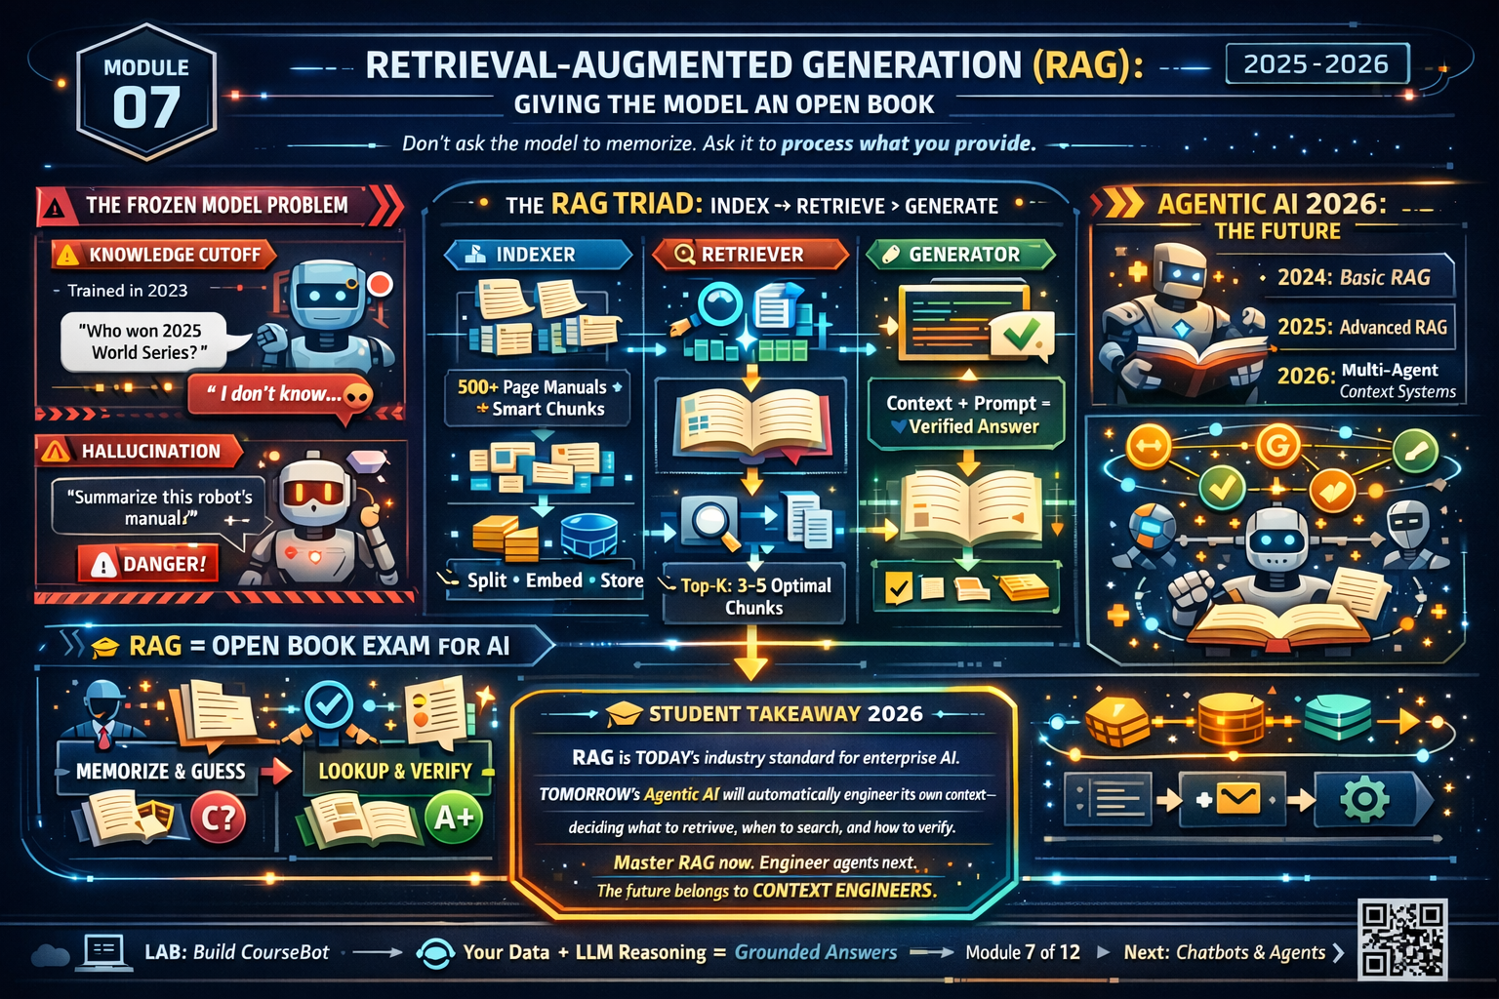

Slide 6
The "Open Book Exam" Analogy
Standard LLM (Fine-Tuning):
Student memorizes textbook, throws it away, takes test from memory.
Risk: Memory is fuzzy.
RAG:
Student takes test with textbook open on the desk.
Benefit: Look up exact page, read, synthesize.
Result: High accuracy, verifiable sources.

Slide 7
The Architecture High-Level
The Triad:
1. Indexer: Prepares your private data (PDFs, Wikis, Databases).
2. Retriever: Finds the most relevant "chunks" based on user question.
3. Generator: The LLM takes chunks + question and writes the answer.

Slide 8
Step 1: Ingestion & Chunking (The Art)
Why Chunk? Context Window limits & Cost. Need small, relevant pieces.
Strategies:
Fixed Size: Every 500 chars. (Simple, breaks sentences).
Recursive: Split by paragraphs, then sentences. (Better context).
Semantic Chunking (2025 Standard): Break when topic changes (embedding shifts).
Think of it as Long doc being sliced into overlapping tiles

Slide 9
Step 2: Embedding the Chunks
Recall Module 2: Convert text to Vectors.
The Process:
Pass every chunk through an Embedding Model.
e.g., OpenAI text-embedding-3-small or Hugging Face all-MiniLM-L6-v2.
Result: A list of floating-point numbers representing the meaning.

Slide 10
Step 3: The Vector Database
What is it? DB optimized for similarity search of vectors.
The Landscape:
Azure AI Search: Microsoft, Postgres pgvector, Pinecone: Managed, scalable, cloud-native.
ChromaDB / FAISS: Open-source, runs locally (Our Lab).
Weaviate / Qdrant: Feature-rich, hybrid search.
Robotics Context: The robot stores its map and object definitions here.
Refer: Vector Big Picture – Google Drive

Slide 11
Indexing Visualization
Flow :
[Document] -> [Splitter] -> [Chunks] -> [Embedding Model] -> [Vector DB]
Each step represents a data transformation from raw text to mathematical understanding.
Refer: https://thedataquarry.com/blog/vector-db-1/
Notes:
Show & tell: Azure AI Search

Slide 12
Retrieval: Finding the Needle
The Query: User asks, "How do I reset the servo?"
Vectorization: Convert question into a vector.
Similarity Search (ANN): DB calculates distance (Cosine Similarity) between Question and Stored Chunks.
Top-K: Retrieve the top 3 closest chunks.
Refer: https://thedataquarry.com/blog/vector-db-2/#generative-qa-chatting-with-your-data

Slide 13
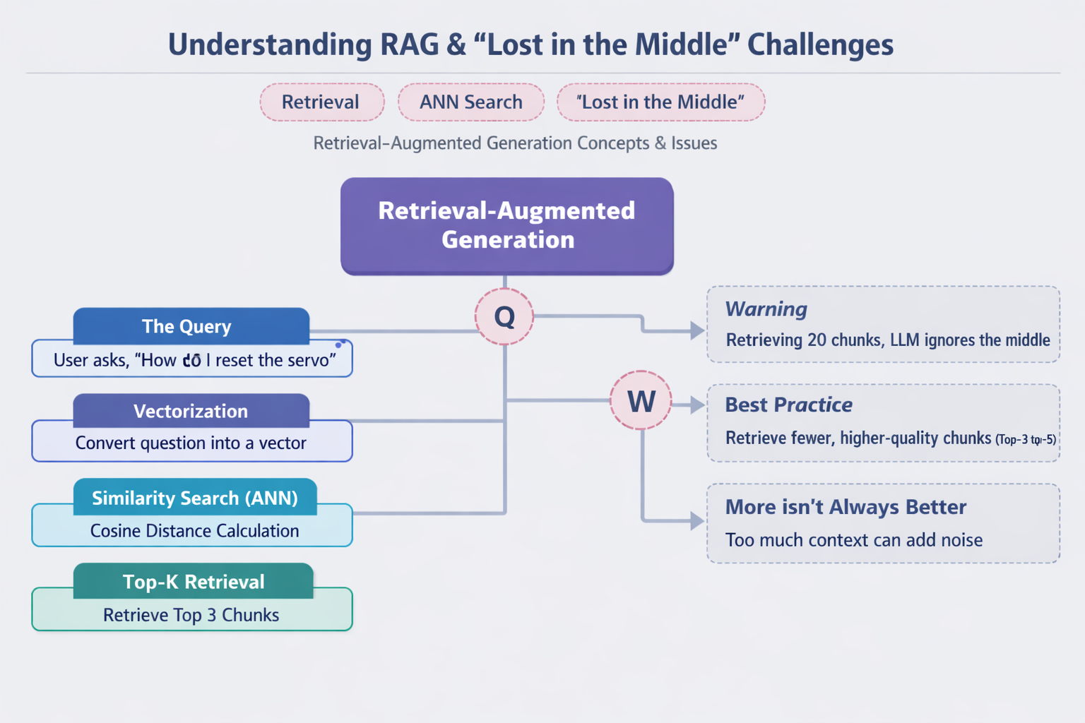

Slide 14
The "Lost in the Middle" Phenomenon
Warning: If you retrieve 20 chunks, the LLM often ignores the ones in the middle.
Best Practice: Retrieve fewer, higher-quality chunks (Top-3 or Top-5).
More context is not always better; it can introduce noise.

Slide 15
Augmentation: The Prompt Template
The "Magic" happens here. We dynamically build a prompt.
System: You are a helpful assistant. Use ONLY the context below to answer. Context: - [Chunk 1 Text] - [Chunk 2 Text] - [Chunk 3 Text] User Question: {question} Answer:

Slide 16

Generation & Citation
The Output: The LLM generates the answer based on provided chunks.
Verification:
Because we know which chunks we sent, we can force citations.
Example: "Reset the servo by holding the red button (Source: Manual Pg 4)."

Slide 17
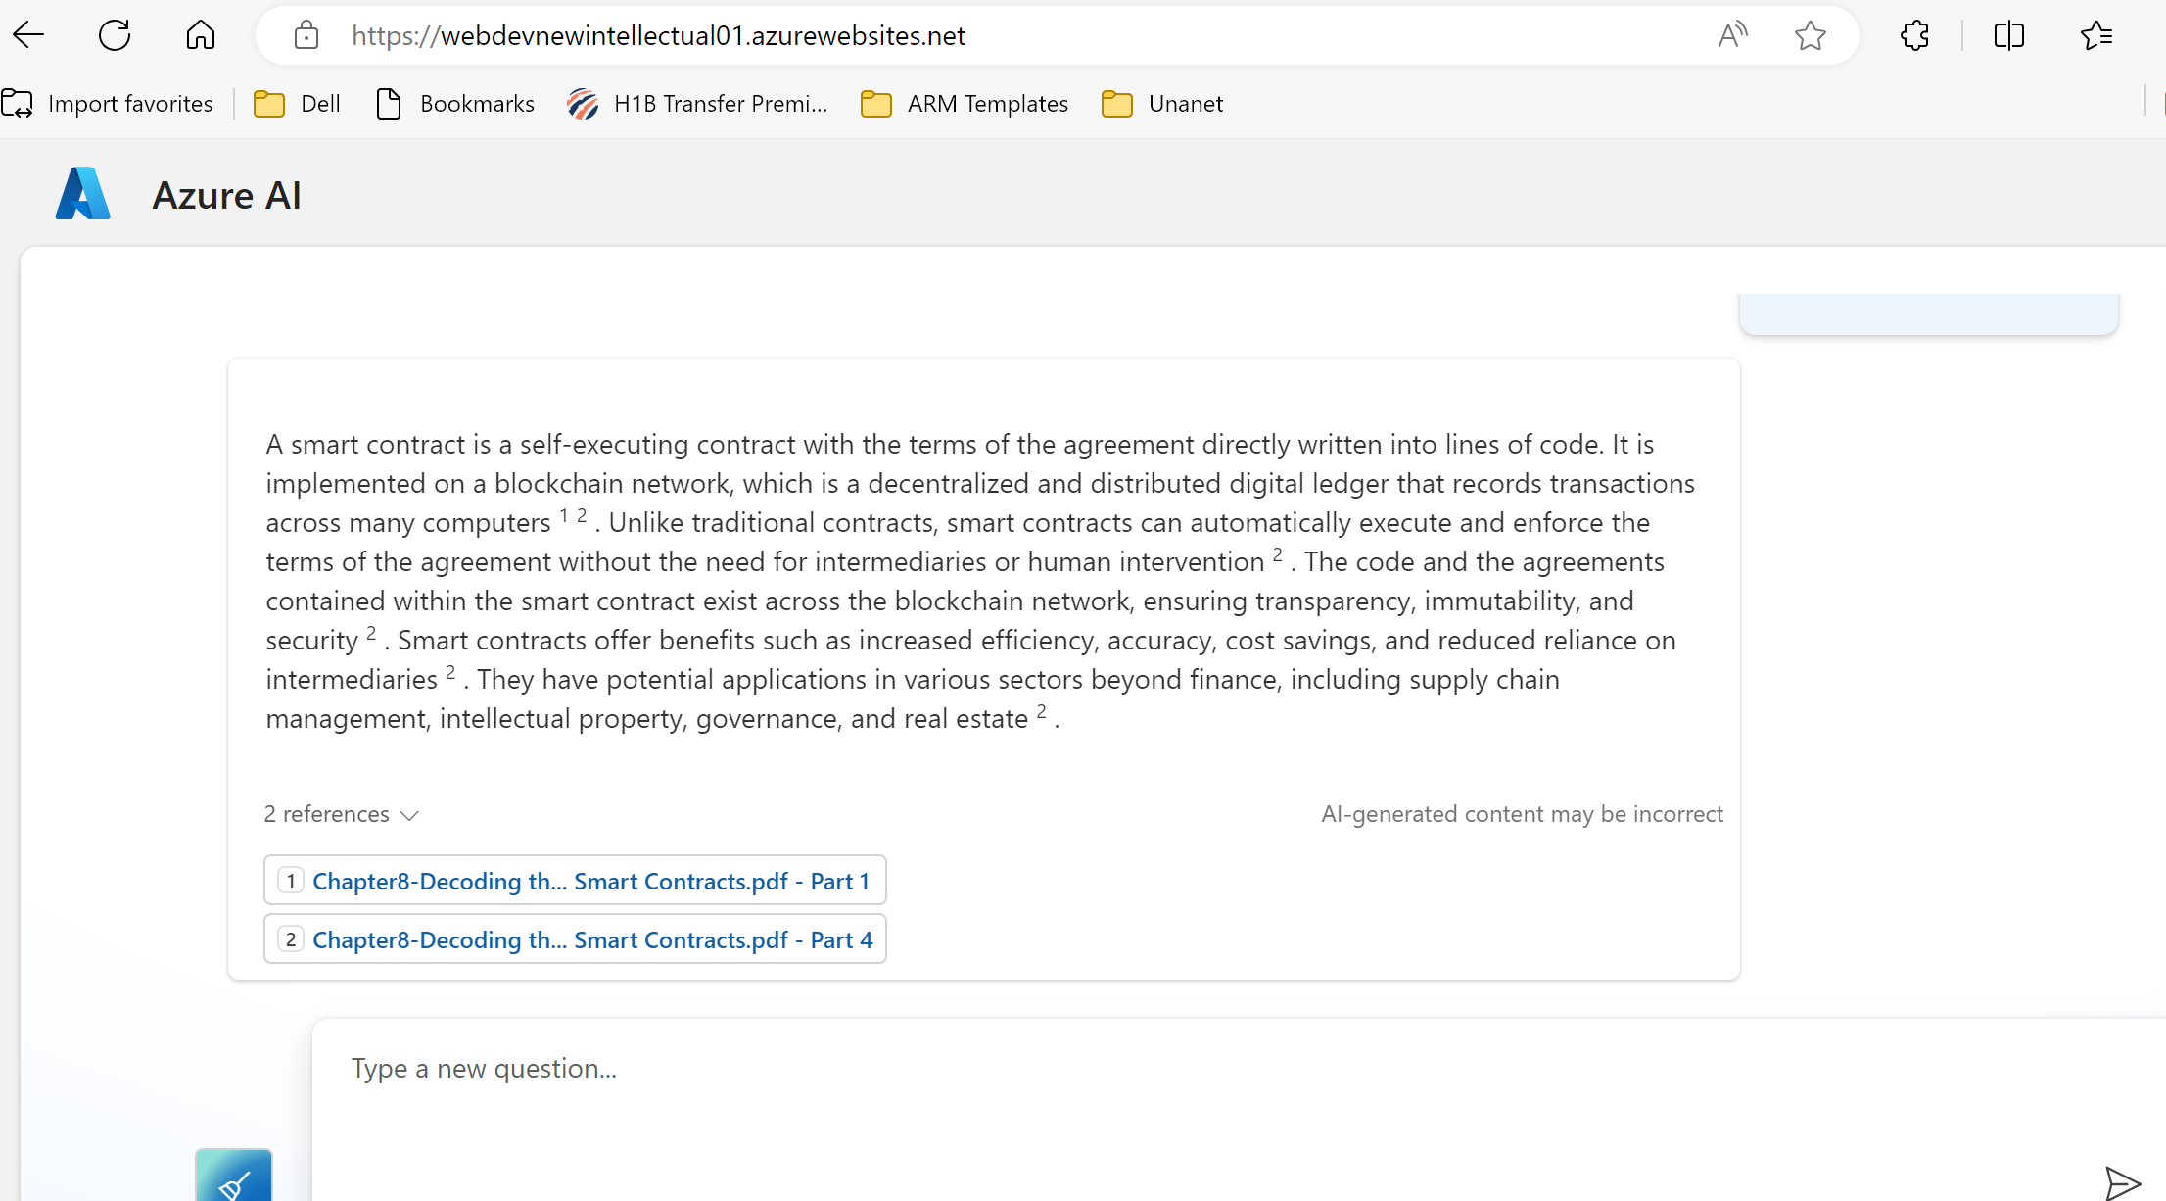
An Enterprise AI Search on Azure with Citations
Source Citation
Notes:
Build Trust Give user the source citation
Provide relevant Enterprise resource for the user Bring confidence – click the link to see the actual pdf

Slide 18

Advanced RAG (The "World Class" Edge)
Hybrid Search:
Vectors are bad at exact part numbers ("#XJ-9"). Keywords (BM25) are good.
Hybrid RAG combines both.
Re-Ranking (Cross-Encoders):
1. Retrieve 50 documents (fast).
2. Use "Re-ranker" model to score against query.
3. Send top 5 to LLM. (Significantly boosts accuracy).

Slide 19
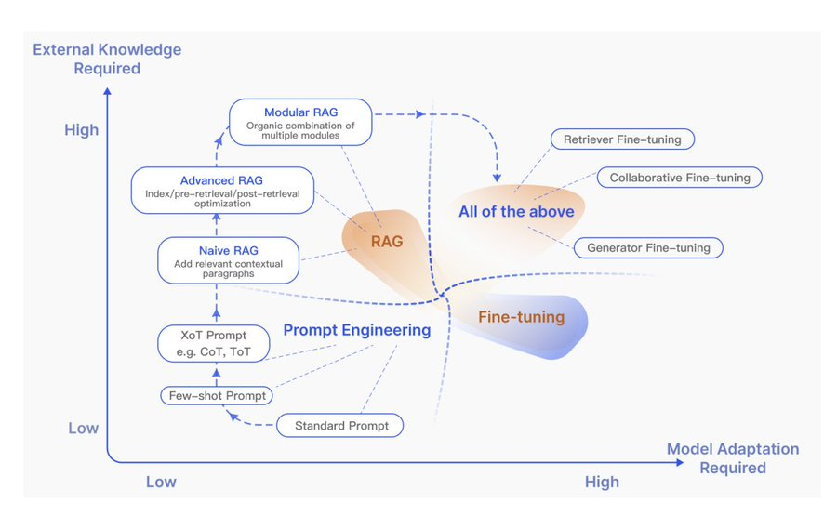
When should I use what?
Reference: https://arxiv.org/pdf/2312.10997
Notes:
RAG compared with other model optimization methods in the aspects of “External Knowledge Required” and “Model Adaption Required”

Slide 20
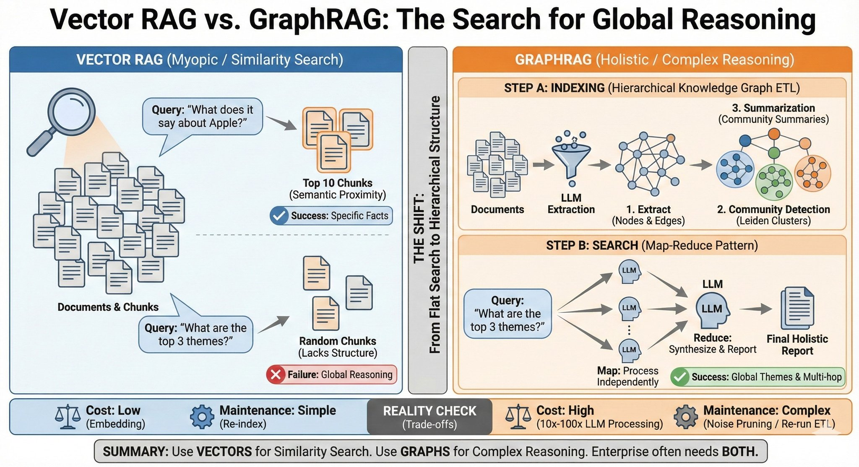
Microsoft Graph RAG: https://microsoft.github.io/graphrag/

Slide 21
Context Engineering 2.0

Slide 22
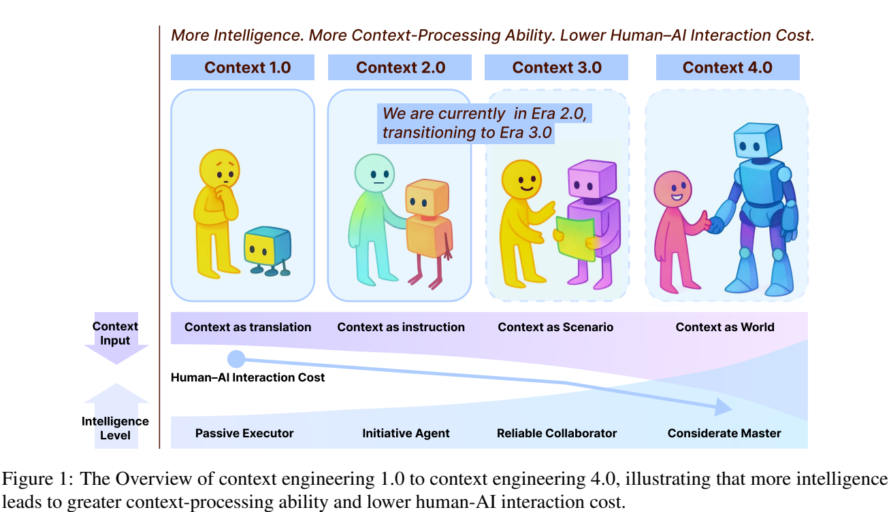
You are here
Optional Listen: https://youtu.be/CA-QTmeAoyg
Source: https://www.arxiv.org/pdf/2510.26493

Slide 23
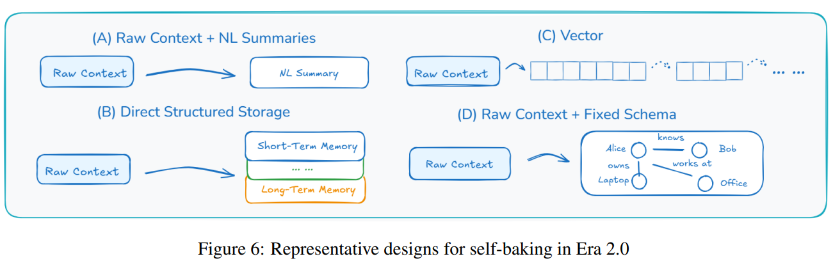
Ontology
Importance of Statefulness
Source: https://www.arxiv.org/pdf/2510.26493
Notes:
Ontology: shared model of business entities, relationships, rules, and objectives Ref: https://blog.fabric.microsoft.com/en-us/blog/from-data-platform-to-intelligence-platform-introducing-microsoft-fabric-iq These are the key business concepts captured or enabled by the ontology in Fabric IQ (Microsoft Unified Data Intelligence Platform):
Entity Types: Real-world or abstract concepts that your business manages (e.g., Plane, Flight, Pilot).
Relationship Types: How entity types relate (e.g., Passenger booked on Flight, Pilot certified for Aircraft Type).
Properties: Facts that describes their state (example: location, fuel level, aircraft model).
Actions: Operations that can be performed on entities (example: reroute aircraft, schedule repair, notify pilot).
Rules: Event-driven triggers that initiate actions (example: if connection time < 20 min, then rebook passengers).

Slide 24
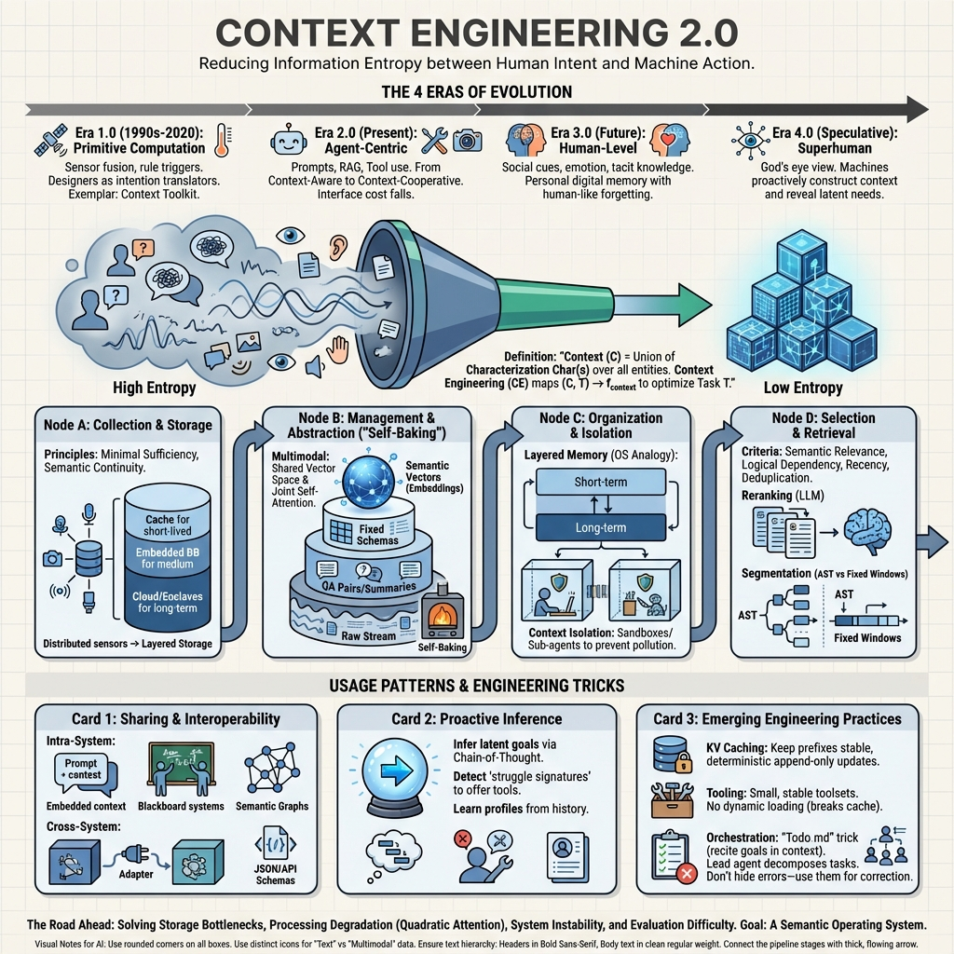
Source: https://www.arxiv.org/pdf/2510.26493
Notes:
My blog for details: https://bhakthan.substack.com/p/context-engineering-20-the-context

Slide 25
Lab Overview: Building "CourseBot"
Goal: Build a QA system for this course's syllabus.
The Stack: PIP Install relevant libraries
Orchestrator: Use your own framework or Lang Chain (The glue code).
Database: Chroma DB (Local vector store).
Embeddings: Huggingface (Free, local).
LLM: OpenAI API or Google Gemini API or local ollama or LM Studio.
Notes:
Refer code: https://github.com/Azure-Samples/azure-search-openai-demo

Slide 26
Step 1: Loading & Splitting
from langchain.document_loaders import TextLoader
from langchain.text_splitter import RecursiveCharacterTextSplitter
# 1. Load Data
loader = TextLoader("syllabus.txt")
documents = loader.load()
# 2. Split (Chunk size 500, overlap 50 to preserve context)
text_splitter = RecursiveCharacterTextSplitter(chunk_size=500, chunk_overlap=50)
chunks = text_splitter.split_documents(documents)

Slide 27
Step 2: Vector Store Creation
from langchain.vectorstores import Chroma
from langchain.embeddings import HuggingFaceEmbeddings
# 3. Create Embeddings & Store
embedding_model = HuggingFaceEmbeddings(model_name="sentence-transformers/all-MiniLM-L6-v2")
# This creates a local folder 'db' with the vectors
vector_db = Chroma.from_documents(chunks, embedding_model, persist_directory="./db")

Slide 28
Step 3: The RAG Chain
from langchain.chains import RetrievalQA
from langchain.llms import OpenAI
# 4. Setup Retrieval
retriever = vector_db.as_retriever(search_kwargs={"k": 3})
# 5. Connect to LLM
qa_chain = RetrievalQA.from_chain_type(
llm=OpenAI(),
chain_type="stuff", # "Stuff" means stuff all chunks into one prompt
retriever=retriever
)
# 6. Ask
response = qa_chain.run("What is the grading policy?")
print(response)

Slide 29

Summary & References
Takeaway: RAG is the industry standard. Combines reasoning (LLM) with facts (DB).
References:
Lewis et al. (2020) "Retrieval-Augmented Generation..."
Lang Chain RAG Tutorials / Pinecone Advanced RAG.
RAG Survey: https://arxiv.org/pdf/2312.10997
Effective Context Engineering - Anthropic: https://www.anthropic.com/engineering/effective-context-engineering-for-ai-agents
Context Engineering 2.0: https://arxiv.org/pdf/2510.26493
AI on AI Podcast: https://www.youtube.com/watch?v=CA-QTmeAoyg
Next Module: Module 8: Chatbots & Agents.
Notes:
INSTRUCTOR NOTES - The "Context Window" Trap:
Students often ask: "Gemini 1.5 has a 1 Million token context window. Is RAG dead?"
Answer: No.
1. Cost: It's expensive to fill 1M tokens every query.
2. Accuracy: "Lost in the Middle" phenomenon still exists.
3. Latency: Processing 1M tokens takes seconds/minutes; RAG takes milliseconds.
Robotics Application: A robot cannot be "Fine-Tuned" every time the environment changes.
If you move a chair, you update the Vector Database (RAG), not retrain the Neural Network.

